Slide 1

Bank Direct Marketing
COURSE: CAPSTONE:CREATE VALUE FROM OPEN DATA

Slide 2
Data and analysis framework
Variable:
1 - age (numeric)
2 - job : type of job (categorical: "admin.","unknown","unemployed","management","housemaid","entrepreneur","student",
"blue-collar","self-employed","retired","technician","services")
3 - marital : marital status (categorical: "married","divorced","single"; note: "divorced" means divorced or widowed)
4 - education (categorical: "unknown","secondary","primary","tertiary")
5 - default: has credit in default? (binary: "yes","no")
6 - balance: average yearly balance, in euros (numeric)
7 - housing: has housing loan? (binary: "yes","no")
8 - loan: has personal loan? (binary: "yes","no")
9 - contact: contact communication type (categorical: "unknown","telephone","cellular")
10 - day: last contact day of the month (numeric)
11 - month: last contact month of year (categorical: "jan", "feb", "mar", ..., "nov", "dec")
12 - duration: last contact duration, in seconds (numeric)
13 - campaign: number of contacts performed during this campaign and for this client (numeric, includes last contact)
14 - pdays: number of days that passed by after the client was last contacted from a previous campaign (numeric, -1 means client was not previously contacted)
15 - previous: number of contacts performed before this campaign and for this client (numeric)
16 - poutcome: outcome of the previous marketing campaign (categorical: "unknown","other","failure","success")
Data Pre-processing:
Data is pre-processed by converting all categorical value into numerical, and modifying unknown values
GETTING DATA:
Data is available:
https://archive.ics.uci.edu/ml/datasets/Bank+Marketing#
EXPLORETORY DATA ANALYSIS:
In EDA we analysed which group of people more likely to subscribe a term deposits
REPORTING AND CONCLUSION:
Based on the analysis we have done we develop how to increase no of people to increase subscription and to target specific group of peoples

Slide 3
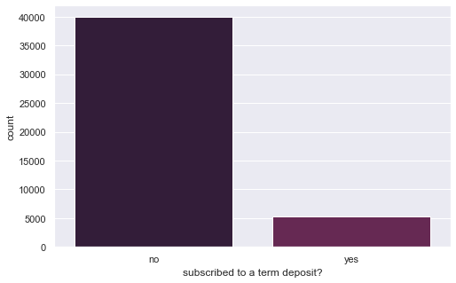
Overall subscription of a term deposit
Decreasing number of subscription
Bank is not satisfied with the subscription count
ANALYSIS OF DATA:
Most of the clients are not subscribing to term deposit
Goal is to improve subscription count and increase revenue

Slide 4
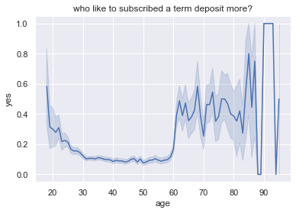
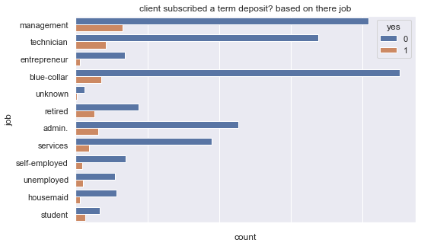
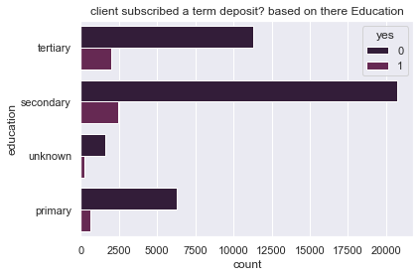
Which group has highest subscription?
People between age 65-80 and above 90 has the highest rate of subscription
People who works in management has relatively high number of subscription
Among the lowest students has relatively high subscription mainly those students who are in secondary
This is a valuable information which can be used to increase subscription no by focusing on groups who can improve most

Slide 5
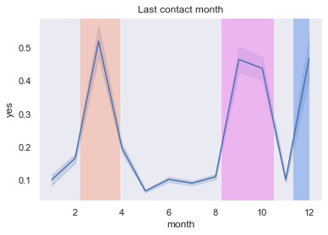
When to contact client for subscription?
Methods: Each year the average client’s subscription count when contacted is clustered into three groups –
February ,March , April (PLATINUM)
August, September (GOLD)
December (SILVER)
Findings:
There is increase of subscription is 150 % during Platinum, Gold and Silver season
On average there is 50% drop in subscription during off season
Note: During Platinum, gold and silver we have to focus on clients more and increase the number of contacts with them.

Slide 6
EDA conclusion
Most of the client isn’t subscribing a term deposit
We have to increase subscription rate between the age 20-60,
We have to target main working professionals to increase the subscription count
-Mainly older people are interested in term deposit and those people who are in management.
-Entrepreneur has the lowest subscription count
There is three pick season when people tend to subscribe more

Slide 7
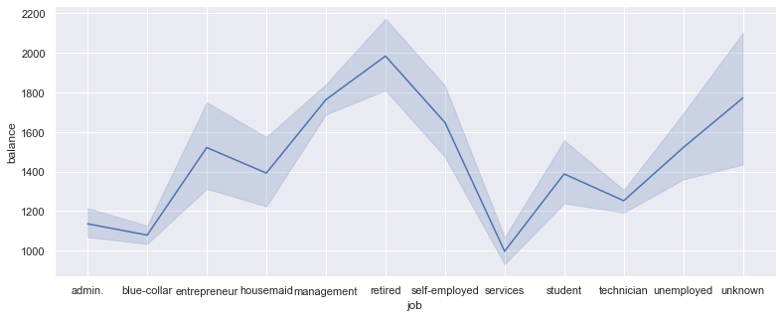
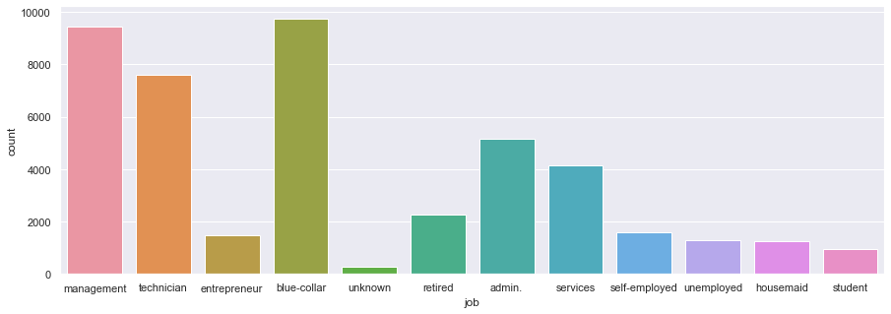
How to increase subscription?
We have to focus on each group based on there specific need as it will increase recurring subscriptions
As student has relatively low money, we need new term deposit focusing on them EMI scheme , flexible time
We have to make new term deposit which is friendly towards working class people, give better return for subscribing to longer term deposite .
Alternative scheme for entrepreneur which will much more
friendly to them.
Terms extension, low Emi for people who are unemployed or self-employed
We have to be flexible and provide customized subscription plan to each group of clients based on their requirements

